Slide 1
Workshop 2 : GGPLOT
09/11/2023

Slide 2
Exercise 1: Barplots and Distributions
1- Load the data from small_file.txt using read_delim
Plot out a barplot of the lengths of each sample from category A
Start by filtering the data to keep only Sample A samples
small %>% filter(Category == "A")
Pass this filtered tibble to ggplot
Your x aesthetic will be Sample and your y will be length
Since the value in the data is the bar height you need to use geom_col
Plot out a barplot (using geom_bar) of the mean length for each category in small.file
You will need to set stat="summary", fun="mean" in geom_bar so it plots the mean value
Add a call to geom_jitter() to the last plot so you can also see the individual points
Colour the points by Category and decrease the width of the jitter columns to get better separation. Make sure height is set to 0
If you don’t want to see the legend then you can set show.legend=FALSE in geom_jitter.
2- Load the data from expression.txt using read_delim.
Plot out the distribution of Expression values in this data. You can try both geom_histogram and geom_density. Try changing the color and fill parameters to make the plot look prettier. In geom_histogram try changing the binwidth parameter to alter the resolution of the distribution.
3- Load the data from cancer_stats.csv using read_delim.
Plot a barplot (geom_col) of the number of Male deaths for all Sites. (x=Site, y=`Male Deaths`) make sure you let the RStudio auto-complete help you to fill in the Male Deaths column name so you get the correct backtick quotes around it.
You won’t be able to show all of the categories so just show the first 5 (cancer %>% slice(1:5) %>% ggplot…)
4- Load the data from child.variants.csv.
Create a new variable in child.variants loaded from Child_Variants.csv called Good using mutate and if_else. The value should be “GOOD” if QUAL == 200 otherwise it should be “BAD”
Plot out a violin plot, using geom_violin() of the MutantReads for the two Good categories.

Slide 3
Exercise 2: Annotation, Scaling and Colours
Use theme_set to set your ggplot theme to be theme_bw with a base_size of 12. Replot one of your earlier plots to see how its appearance changed.
In the cancer barplot you did in exercise 1 you had to exclude sites because you couldn’t show them on the x axis. Use the coord_flip transformation to switch the x and y axes so you can remove the slice function which restricted you to 5 sites, and show all of the sites again.
Load the data from brain_bodyweight.txt
Plot a scatterplot of the brain against the body
Change the axis labels (xlab and ylab) to say Brainweight (g) and Bodyweight (kg) and add a suitable title (ggtitle).
Both brainweight and bodyweight are better displayed on a log scale – try implementing this in one of the ways below
Turn the axes into log scale axes (scale_x_log10 and scale_y_log10)
Modify the data to be log transformed when creating the aesthetic mapping (pass the column name into log10() when defining the aesthetic mapping in aes())
Use mutate to modify the original data before passing it to ggplot
Color the plot by Category, and change the colours to use the ColorBrewer “Set1” palette (scale_colour_brewer)
Change the ordering of the categories to be “Domesticated”, “Wild”, “Extinct”
Create a barplot of the brainweight of all species, coloured by their bodyweight. Use a custom colour scheme for the colouring of the bars. You will again need to use a log scale for the brain and bodyweight.

Slide 4
Exercise 3: Summary Overlays
Load the data in treatments.csv.
Plot a stripchart of the four conditions using geom_jitter()
Overlay a boxplot of the same data along with the raw points
Adjust the size and width of spread of the points in geom_jitter to something sensible
Adjust the size of the lines in the boxplot
Make sure geom_boxplot is drawn first so you can see everything
Try colouring the points by the condition to see if it’s any clearer.
Plot the same data as a barplot with errorbars for the Standard Error of the Mean (SEM)
Use a geom_bar for the barplot with stat=”summary” and then use stat_summary with a geometry of errorbar with the default mean_se values.
Take the same treatment data and pre-calculate a mean and sd from it using group_by and summarise. Use these pre-calculated values to plot out the same barplot as before.
Replot the stripchart, but instead of overlaying a boxplot, use stat_summary to just add a bar to indicate the mean.

Slide 5
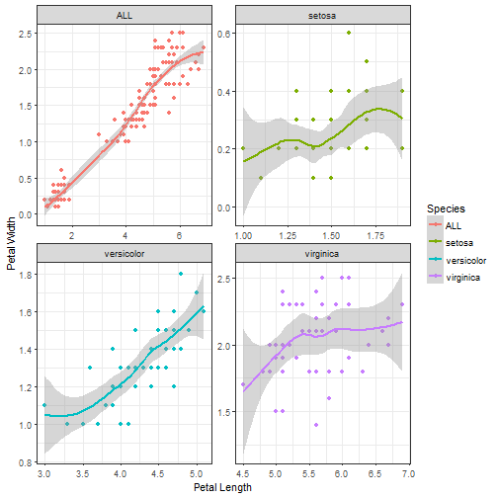
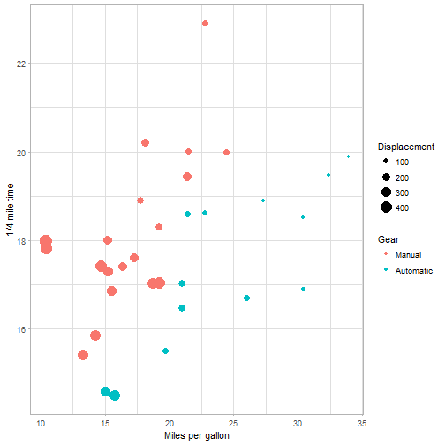
Exercise 4: Faceted smoothing
Load iris dataset and reproduce this plot.
Exercise 5: Bubble-plot
Load mtcars dataset and reproduce this plot.

Slide 6
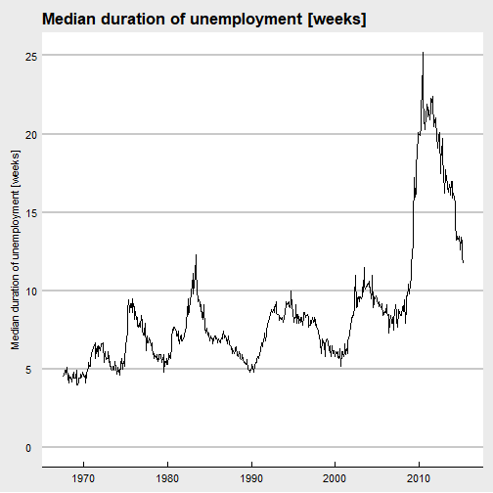
Exercise 6: Economist style
Load economics dataset and reproduce this plot. (Hint: you will need the ggthemes package)

Slide 7
Exercise 7: Msleep dataset
Load msleep dataset.
1. Plot out a scatterplot of brainwt vs bodywt.
2. Plot out the distribution of awake for all categories of vore on the same plot. Change the transparency of colors.
3. Plot out a boxplot of sleep_total for all categories of vore, colored by vore.
4. Plot out a barplot of the number of mammals for all categories of conservation.
5. Plot out a scatterplot of sleep_total vs bodywt in log scale. Use a facet to separate the data for the categories of vore (except NA).

